Slide 1


SONALI SHARMA
January 2023

Slide 2

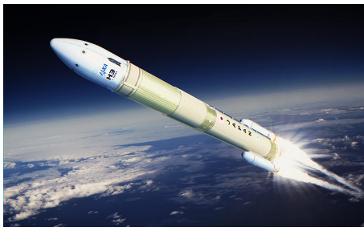
Outline
Executive Summary
Introduction
Methodology
Results
Conclusion
Appendix

Slide 3

Executive Summary
Summary of methodologies
Data Collection with API and Web Scrapping
Data Wrangling
Exploratory Data Analysis Using SQL and Data Visualization
Interactive Visual Analytics
Machine Learning Prediction
Summary of all results
Exploratory data analysis results
Interactive analytics demo in screenshots
Predictive analysis results

Slide 4
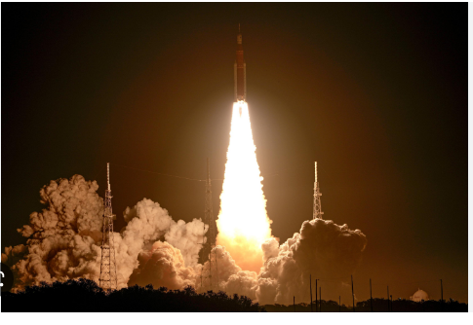
Introduction
Project background and context
We will predict if the Falcon 9 first stage will land successfully. SpaceX advertises Falcon 9 rocket launches on its website with a cost of 62 million dollars; other providers cost upward of 165 million dollars each, much of the savings is because SpaceX can reuse the first stage. Therefore if we can determine if the first stage will land, we can determine the cost of a launch. This information can be used if an alternate company wants to bid against SpaceX for a rocket launch.
Problems you want to find answers
Factors which determine the successful rocket landing.
Factors on which the launch success rate may depend.

Slide 5

Section 1

Slide 6

Methodology
Executive Summary
Data collection methodology:
Data collected from Space X API and by using Web Scrapping.
Perform data wrangling
Use of one hot encoding to convert outcomes into values.
Perform exploratory data analysis (EDA) using visualization and SQL
Perform interactive visual analytics using Folium and Plotly Dash
Perform predictive analysis using classification models
Standardize and split the data and find best methods for classification.

Slide 7

Data Collection
Data sets were collected by following methods:
- Data was collected using get request to the Space X API.
- Decoded the response content as a Json and turn it into Pandas data frame.
- We cleaned the data and removed the missing values by using replace() function to replace nan values.
- Use web scraping with Beautiful Soup to extract Falcon 9 launch records HTML table.
- Finally parse the table and convert it into pandas data frame.

Slide 8
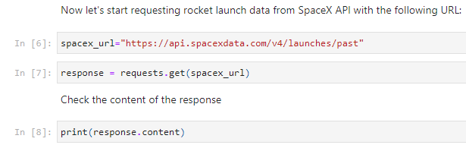
Data Collection – SpaceX API
We used get request to the SpaceX API and clean the requested data by using basic data wrangling and formatting.
The link for this notebook https://github.com/s-sharma22/project-repo.git
Place your flowchart of SpaceX API calls here

Slide 9
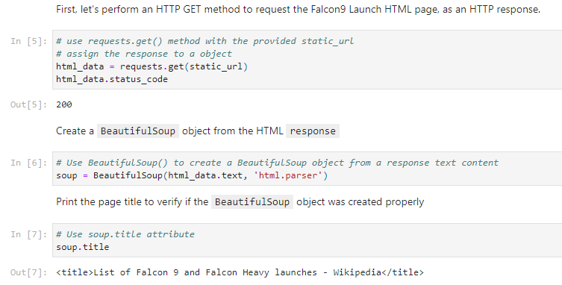
Data Collection - Scraping
Performed web scraping to collect Falcon 9 historical launch records by using BeautifulSoup.
The link for this notebook https://github.com/s-sharma22/project-repo.git
Place your flowchart of web scraping here

Slide 10
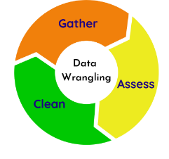
Data Wrangling
We performed some exploratory data analysis to find patterns in the data and determine the label for training models.
Calculated the number of launches on each site and number of occurrence of each orbit.
Created a landing outcome label from outcome column.
The link for this notebook https://github.com/s-sharma22/project-repo.git

Slide 11

EDA with Data Visualization
Visualized the relationship between flight number and launch sites, payload and launch sites, success rate of each orbit type , flight number and orbit type and the launch success yearly trend.
The link for this notebook https://github.com/s-sharma22/project-repo.git

Slide 12

EDA with SQL
We loaded the spacex dataset using database console LOAD tool in DB2.
Wrote and execute the following SQL queries
- Names of unique launch sites in space mission.
- Total payload mass carried by boosters launched by NASA.
- Total no. of successful and failure mission outcomes.
- Failed landing outcomes in drone ship their booster versions and launch site names.
The link for this notebook https://github.com/s-sharma22/project-repo.git

Slide 13

Build an Interactive Map with Folium
We marked all launch sites on map by using markers, circles and lines.
Marked the success and failed launches for each site on the map.
If the launch was successful we use a green marker and if launch was failed we use a red marker.
Calculated the distances between a launch site to its proximities.
Found answers to questions like :
Are launch sites in close proximity to railways, highways and coastline?
Do launch sites keep certain distances away from cities?

Slide 14

Build a Dashboard with Plotly Dash
Built an interactive dashboard that contains pie charts and scatter plots to analyze data with the Plotly Dash Python library
Built a dashboard to analyze launch records interactively with Plotly Dash.
Plotted scatter graph to show the relationship between outcome and payload mass.
The link for this notebook https://github.com/s-sharma22/project-repo.git

Slide 15

Predictive Analysis (Classification)
- Loaded the data using numpy and pandas.
- Transformed the data and split into training and testing set.
- Built different machine learning models and create a GridSearchCV.
- Calculated the accuracy for each method.
- Found best performing classification model.
The link for this notebook https://github.com/s-sharma22/project-repo.git

Slide 16
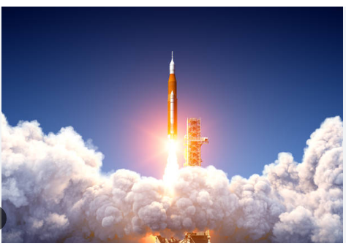
Results
Exploratory data analysis results
Interactive analytics demo in screenshots
Predictive analysis results

Slide 17

Section 2

Slide 18
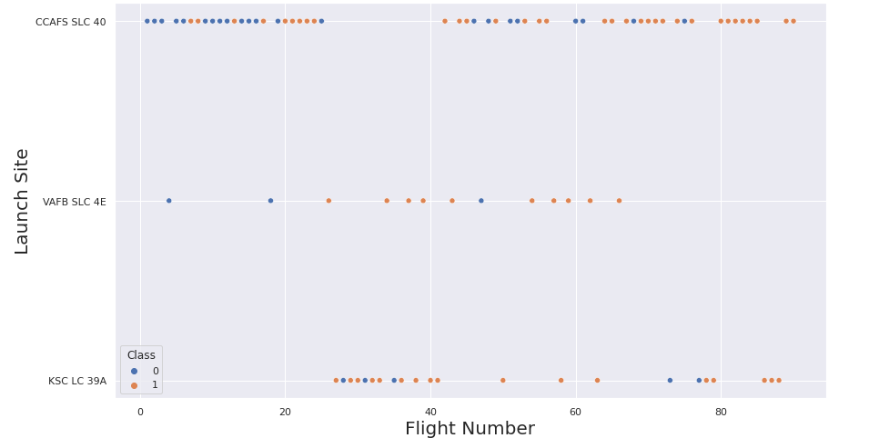
Flight Number vs. Launch Site
In this scatter plot we observe the relationship between flight number and Launch site.
Larger the flight number more is the success rate at launch site.

Slide 19
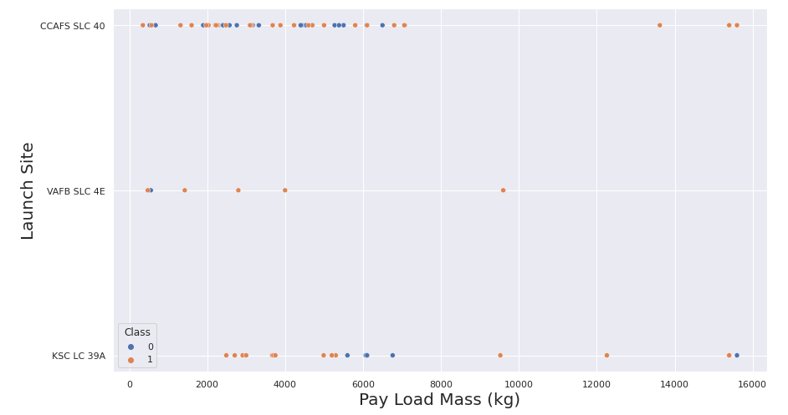
Payload vs. Launch Site
Payload vs. launch site scatter plot shows for VAFB-SLC launch site there are no rockets launched for heavy payload mass.

Slide 20
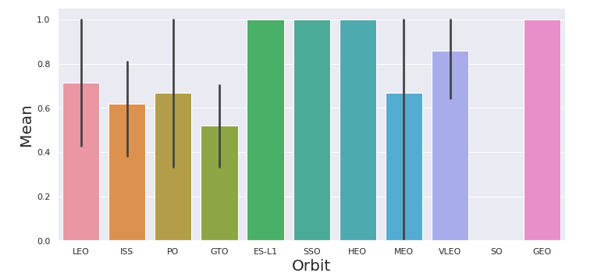
Success Rate vs. Orbit Type
Looking at the plot we can see ES-L1, GEO, HEO, SSO, and VLEO are the orbits that have high success rate. The SO has the least success rate amongst the orbits.

Slide 21
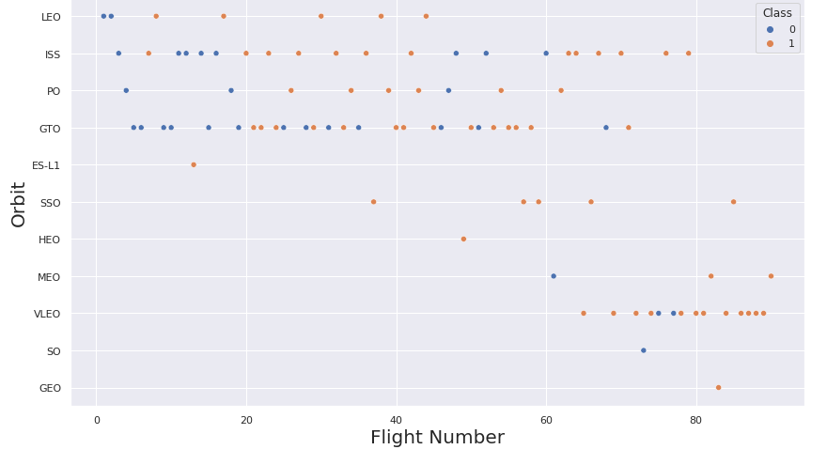
Flight Number vs. Orbit Type
We observe that in LEO orbit the success appears related to the number of flights, on the other hand there seems to be no relationship between flight number when in GTO orbit.

Slide 22
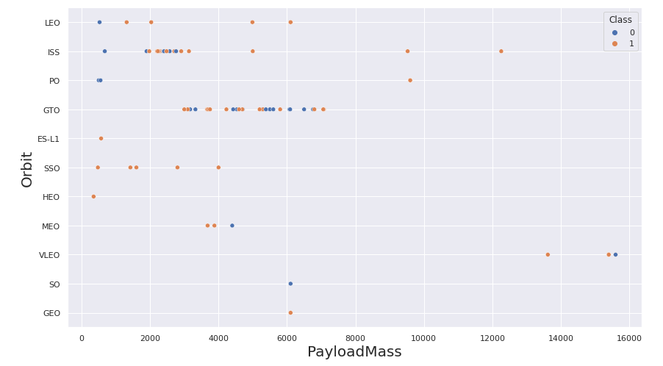
Payload vs. Orbit Type
In this plot we observe that with heavy payloads the successful landing rate are more for Polar, LEO and ISS.

Slide 23
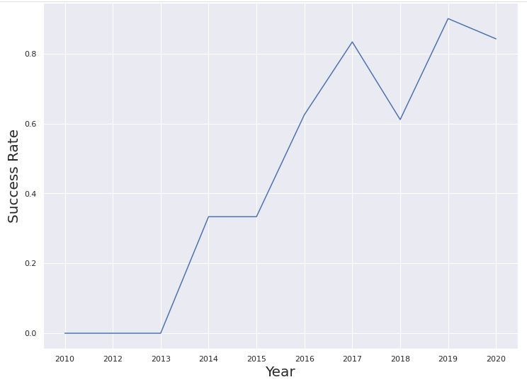
Launch Success Yearly Trend
This shows that the success rate since 2013 kept increasing till 2020.

Slide 24
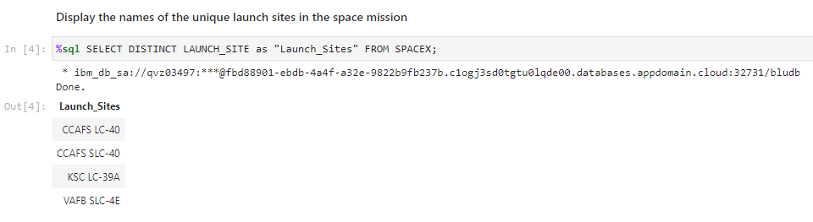
All Launch Site Names
This query display the names of the unique launch sites in the space mission from the table space x.

Slide 25
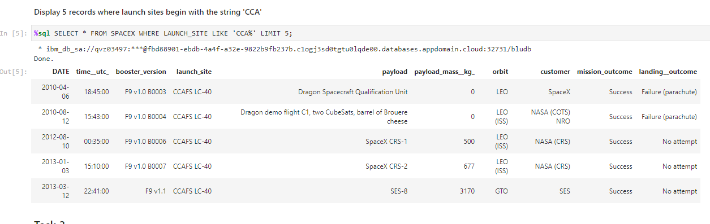
Launch Site Names Begin with 'CCA'
LIKE keyword displays the launch site names which start from CCA.

Slide 26
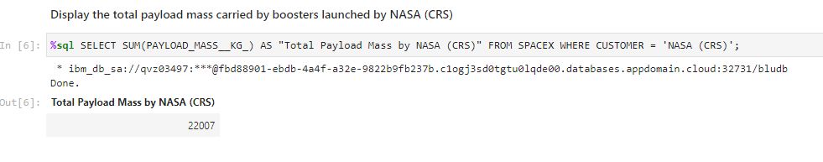
Total Payload Mass
SUM calculates the total payload mass carried by boosters launched by NASA.

Slide 27
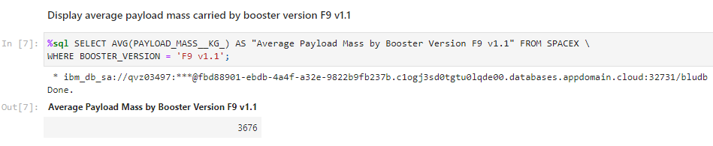
Average Payload Mass by F9 v1.1
This query shows the average payload mass carried by booster version F9 v1.1

Slide 28
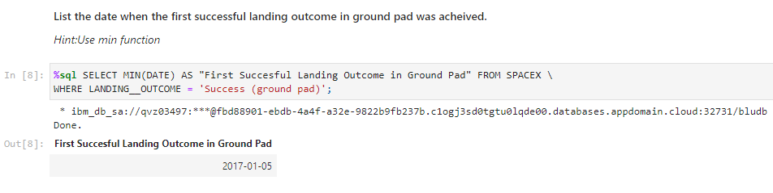
First Successful Ground Landing Date
We observe that the first successful ground landing occurred in the year 2017.

Slide 29
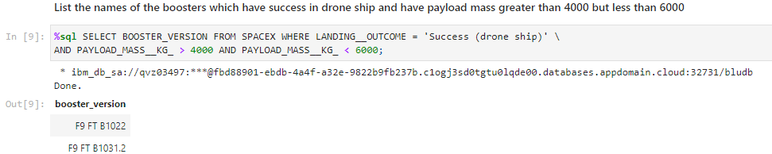
Successful Drone Ship Landing with Payload between 4000 and 6000
The names of boosters which have successfully landed on drone ship and had payload mass greater than 4000 but less than 6000 are displayed through this query.

Slide 30
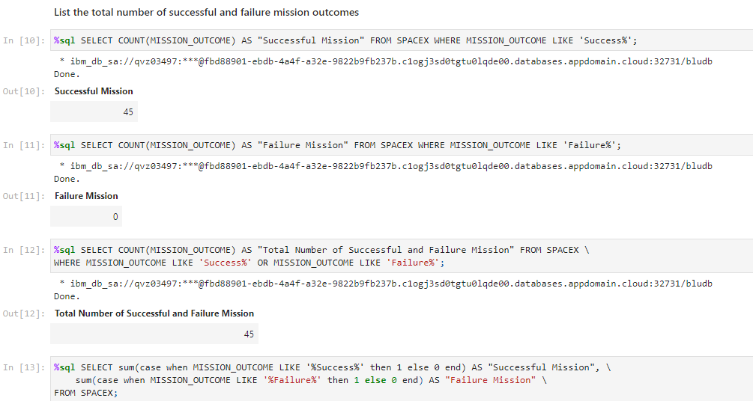
Total Number of Successful and Failure Mission Outcomes
Calculate the total number of successful and failure mission outcomes
Present your query result with a short explanation here

Slide 31
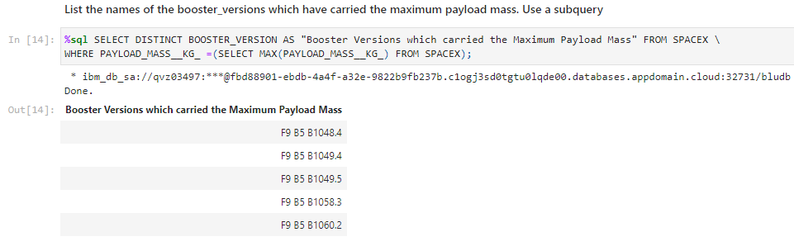
Boosters Carried Maximum Payload
Using MAX function in sub query we can determine the names of the booster which have carried the maximum payload mass.

Slide 32
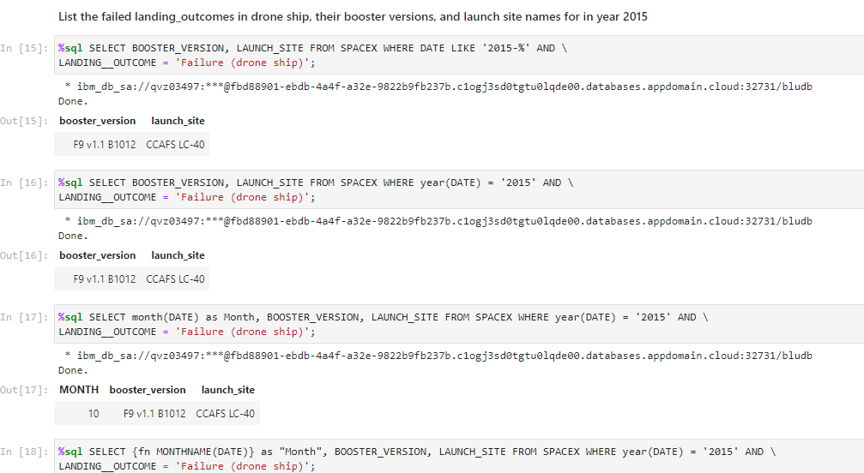
2015 Launch Records
List the failed landing_outcomes in drone ship, their booster versions, and launch site names for in year 2015
Present your query result with a short explanation here

Slide 33
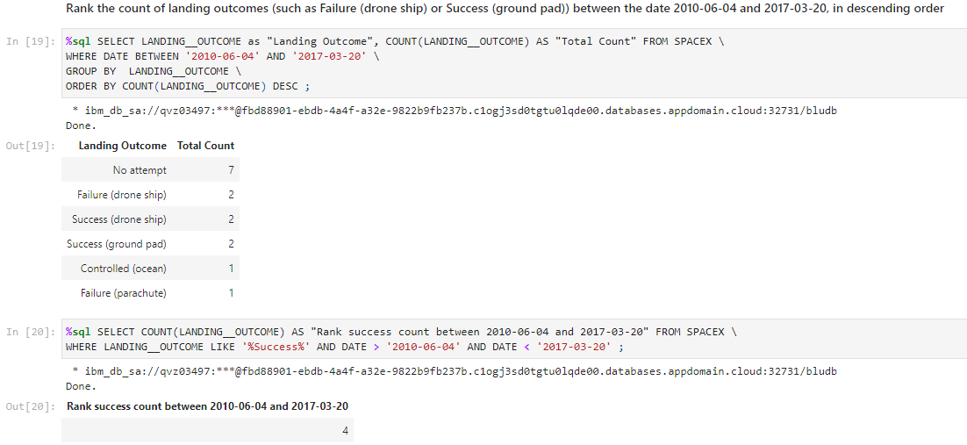
Rank Landing Outcomes Between 2010-06-04 and 2017-03-20
Used GROUP BY and ORDER BY clause to display landing outcomes in descending order.

Slide 34

Section 3

Slide 35
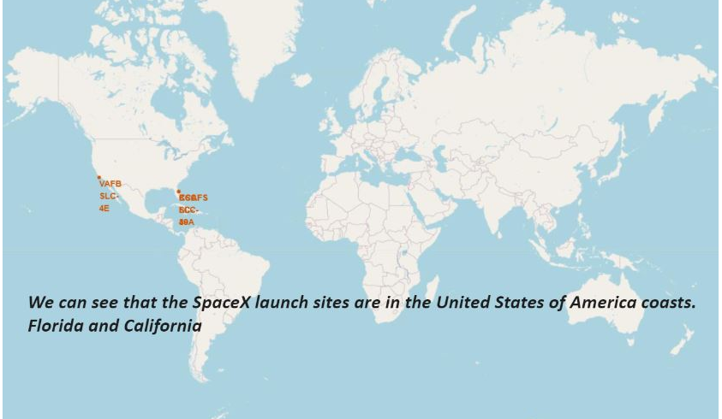
Map With All Launch Sites
Replace <Folium map screenshot 1> title with an appropriate title
Explore the generated folium map and make a proper screenshot to include all launch sites’ location markers on a global map
Explain the important elements and findings on the screenshot

Slide 36

Launch Sites With Color Labels
Replace <Folium map screenshot 2> title with an appropriate title
Explore the folium map and make a proper screenshot to show the color-labeled launch outcomes on the map
Explain the important elements and findings on the screenshot

Slide 37
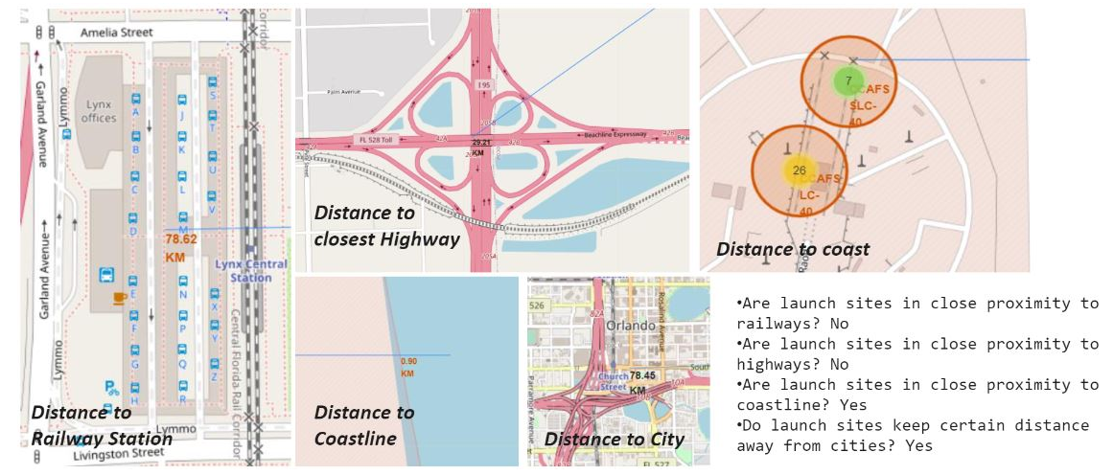
Distances between Launch Site to Its Proximities
Replace <Folium map screenshot 3> title with an appropriate title
Explore the generated folium map and show the screenshot of a selected launch site to its proximities such as railway, highway, coastline, with distance calculated and displayed
Explain the important elements and findings on the screenshot

Slide 38

Section 4

Slide 39
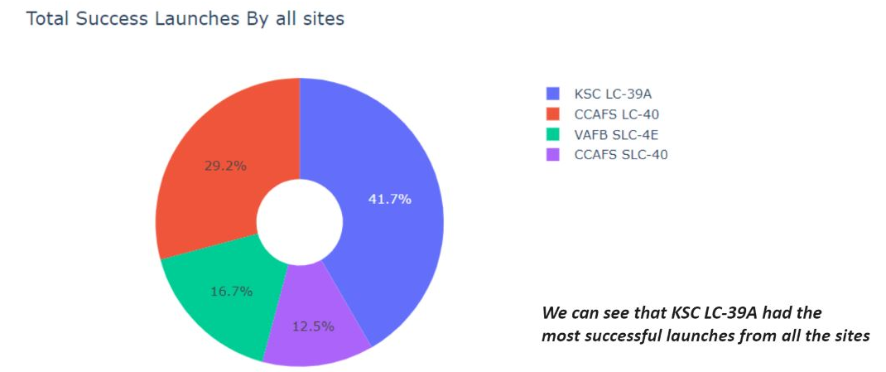
Success Percentage of Launch Sites
Replace <Dashboard screenshot 1> title with an appropriate title
Show the screenshot of launch success count for all sites, in a piechart
Explain the important elements and findings on the screenshot

Slide 40
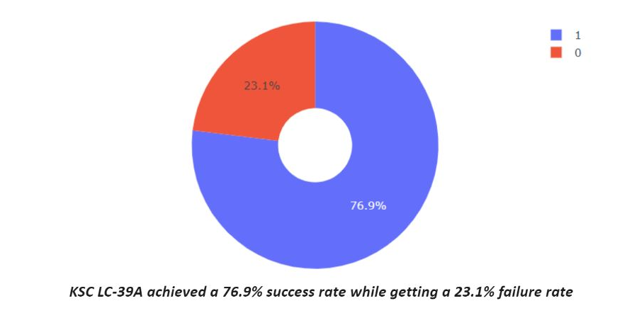
Launch Site with highest launch success ratio
Replace <Dashboard screenshot 2> title with an appropriate title
Show the screenshot of the piechart for the launch site with highest launch success ratio
Explain the important elements and findings on the screenshot

Slide 41
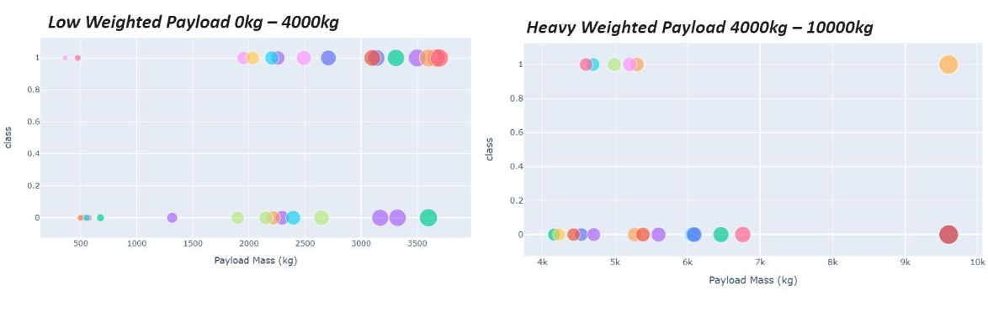
Payload and Launch Outcome for all sites
Replace <Dashboard screenshot 3> title with an appropriate title
Show screenshots of Payload vs. Launch Outcome scatter plot for all sites, with different payload selected in the range slider
Explain the important elements and findings on the screenshot, such as which payload range or booster version have the largest success rate, etc.

Slide 42

Section 5

Slide 43
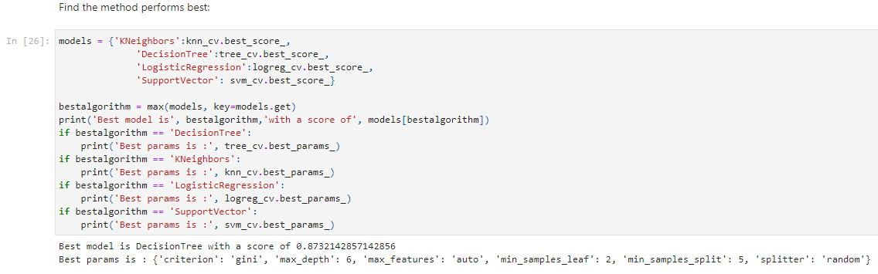
Classification Accuracy
Decision Tree classifier model has the highest classification accuracy of 0.873

Slide 44
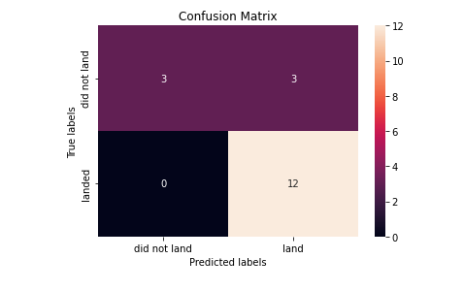
Confusion Matrix
The confusion matrix here visualize and summarize the performance of the decision tree classifier.

Slide 45
Conclusions
Low weighted payloads performed better than heavier payloads.
The success rate at the launch site is directly proportional to flight number.
The launch success rate increased every year.
ES-L1, GEO, HEO, SSO and VLEO had the most success rate.
KSC LC-39A had the most successful launches.
The best machine learning algorithm is the decision tree classifier with highest accuracy.

Slide 46


